Slide 1
Endocrine System
Part One

Slide 2
Glands and Hormones
• Endocrine glands:
are ductless glands, which pour their secretions (hormones) into blood stream.
• Hormone:
is a chemical substance produced by an endocrine gland and carried by the blood to target organs. A hormone alters the activity of one or more specific target organs.

Slide 3
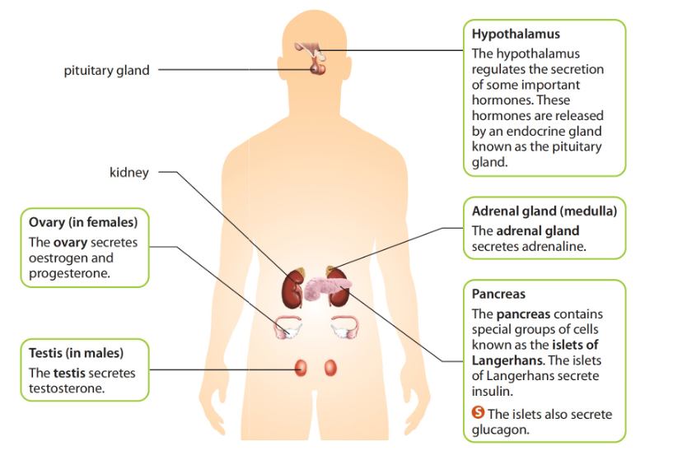
Major Endocrine Glands

Slide 4
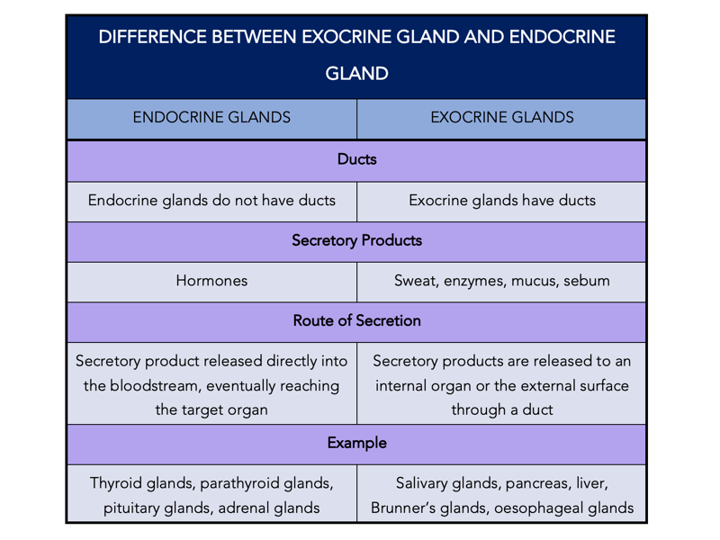
Endocrine VS Exocrine

Slide 5
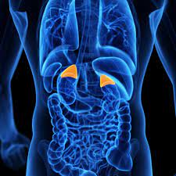
Adrenaline
is a hormone produced by adrenal glands and particularly.
We have two adrenal glands, one above each kidney.
• Adrenaline is secreted in response to stressful situation.
• It is called emergency hormone because it is secreted in cases of fear, fight and flight.

Slide 6
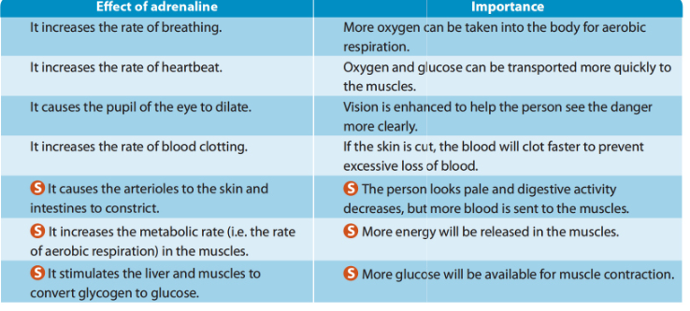
Importance of Adrenaline

Slide 7
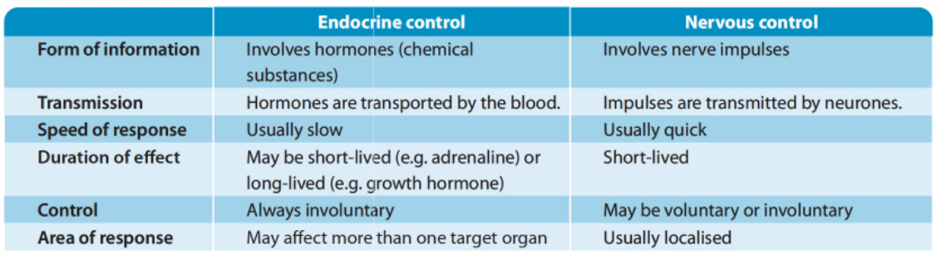
Endocrine Vs Nervous

Slide 8
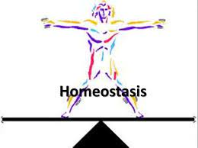
Homeostasis
Homeostasis, the maintenance of a constant internal environment

Slide 9
Variable need to be constant
Temperature: Enzymes in the body can only work within a certain range of temperature
Changes in body temperature can cause enzymes to become inactive or denatured
PH and water potential: to keep tissue fluid with constant pH and water potential for enzymatic activity and cells sustainability
Blood glucose concentration: for cellular respiration and providing energy for the cells

Slide 10
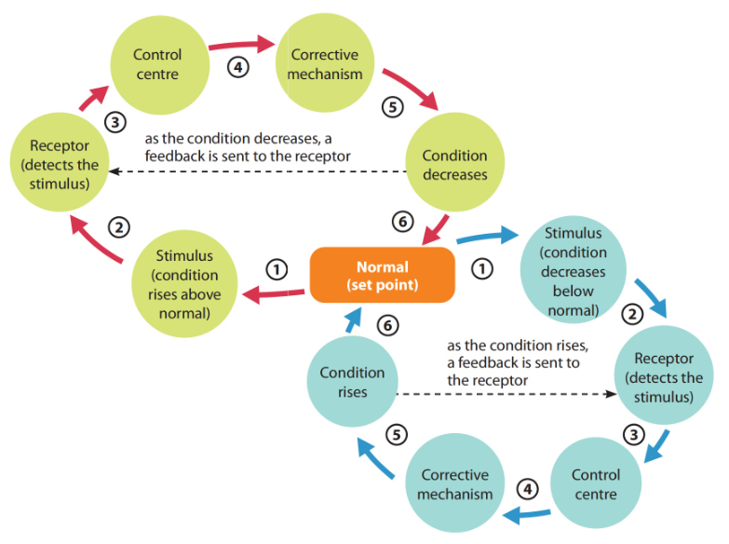
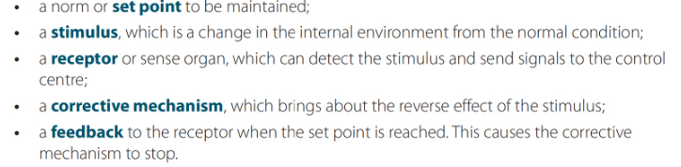
Negative feedback

Slide 11
Regulation of blood glucose concentration
• Cells need a steady supply of glucose to allow them to respire and release the energy they need;
• Too much glucose in the blood can cause water to move out of cells and into the blood by osmosis.
• The control of blood glucose concentration is carried out by the pancreas and the liver.
• There are groups of cells in the pancreas called islets of Langerhans;
• They make two hormones called insulin and glucagon.

Slide 12
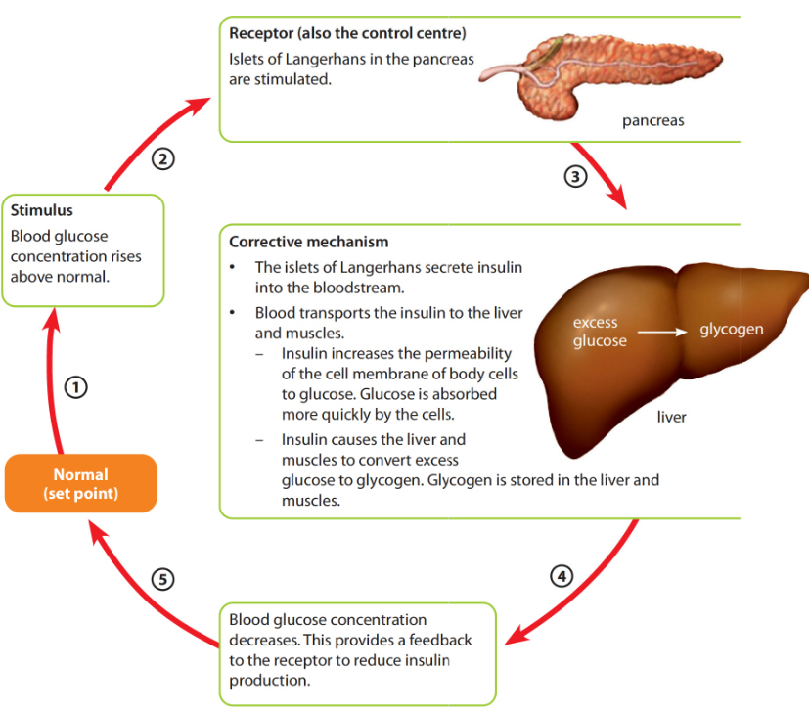
When glucose concentration rises above normal level

Slide 13
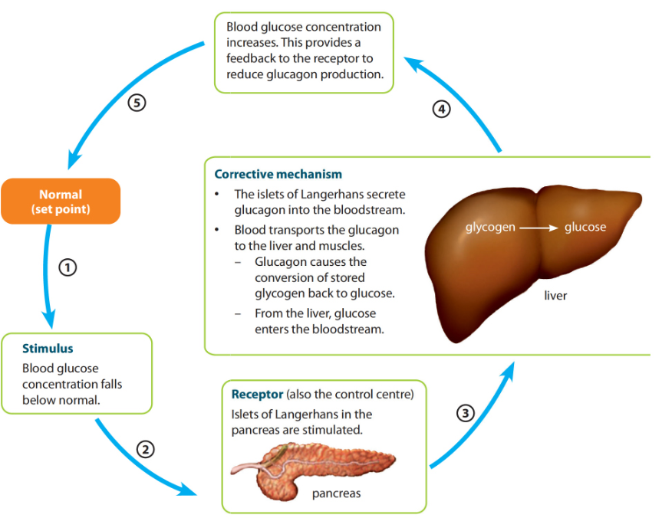
When glucose concentration falls below normal level

Slide 14
Type 1 Diabetes (No Insulin secreted by islets of Langerhans, glucose cannot be stored as glycogen
Signs
Treatment
High blood glucose level
Glucose excreted in the urine
Slow wound healing
Feeling thirsty most of the time
Weight loss
fatigue
Injection of Insulin
Diet(Avoid excessive intake of glucoe

Slide 15
Hypoglycemia
• If a person does not eat carbohydrates for a long time, this may cause the blood glucose concentration to drop vey low. Why?
• Because no insulin has been secreted, the liver has not built up of stores of glycogen that can now be broken down to produce glucose. The person has hypoglycemia.
• The person feels very tired and may show confusion and can become unconscious. This is because cells do not have a supply of glucose to release energy by respiration.

Slide 16
Temperature

Slide 17
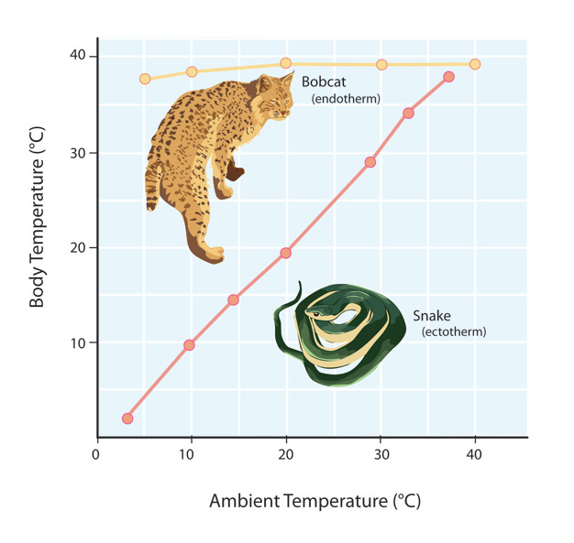
Poikilotherms and Homoiotherms
Poikilotherms have body temperature that vary with the surrounding temperatures
• Homoiotherms are those that are able to have constant body temperature irrespective of the surrounding temperature.
• Homoiotherms (mammals and birds)get their heat energy from food, by respiration. Because of this, they have to eat far more food than poikilotherm ones.

Slide 18
Advantages of being a homoiotherms:
Live in areas with different climatic conditions
Stay active throughout the year
Metabolic reactions can occur as enzymes work within a narrow range of temperature
It can feed throughout the year and do not need to hibernate

Slide 19
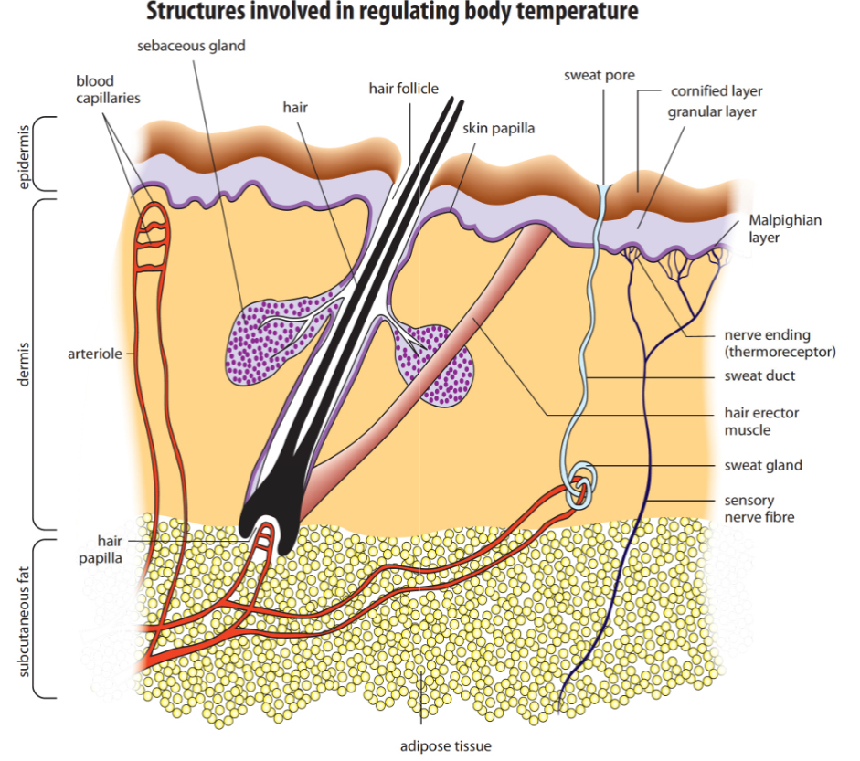
Structure of Skin
• Human skin is made of two layers:
• The epidermis: the top layer of the skin;
• The dermis: the lower layer.

Slide 20
Epidermis
• All cells in the epidermis are made in the layer of dividing cells at the base of it. As they move to surface, they die.
• The top layer of the skin is made up of dead cells, called the cornified layer.
• The cornified layer is hard and waterproof, it protects the softer, living cells underneath.
Some cells in the epidermis contain a dark pigment, called melanin. Melanin absorbs the harmful ultraviolet rays in sunlight, which would damage the living cells in the deeper layers.
• A hair grows from one of the hair follicles in the dermis. Hairs are made of keratin.

Slide 21
Dermis
• The dermis contains elastic fibers and collagen fibers.
• As the person gets older, the fibers loose their elasticity, so the skin becomes loose and wrinkled.
• The dermis also contains:
Blood vessels (arterioles and capillaries) | When dilate, more blood is pushed to the capillaries…..skin become blushed When constrict, less blood flow…skin becomes pale
Hair erector muscles | When muscles contract, hair stands up and pimples appear
Nerve endings | which are sensitive to touch, pain, pressure and temperature
Subcutanuous fat | The fatty tissue helps to insulate your body against heat loss, and also acts as energy reserve
Sweat gland | Secret sweat made of water, salts and little urea

Slide 22
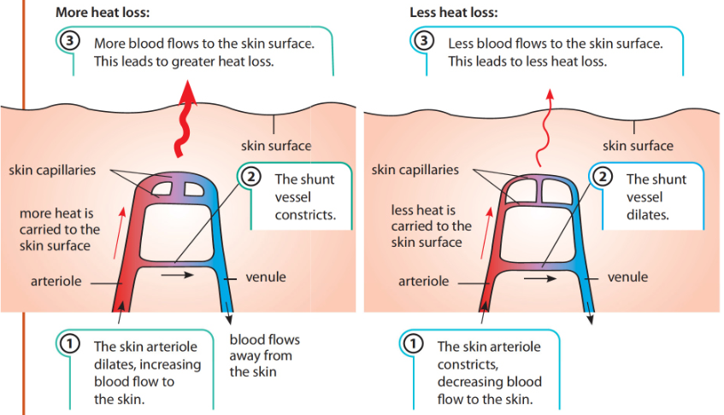
Shunt vessels
Located in some parts of our skins
Connect skin arterioles with skin venules
Control the amount of blood that flow
through the skin capillaries

Slide 23
Regulation of body temperature
Gain heat when:
Lose heat when
Vigorous muscular exercise
Consumption of spicy food
Being in warm environment
Through the skin by radiation, convection and lo limited extent by conduction
Evaporation of the sweat from the surface of the skin
In the feces and urine
In the exhaled air

Slide 24
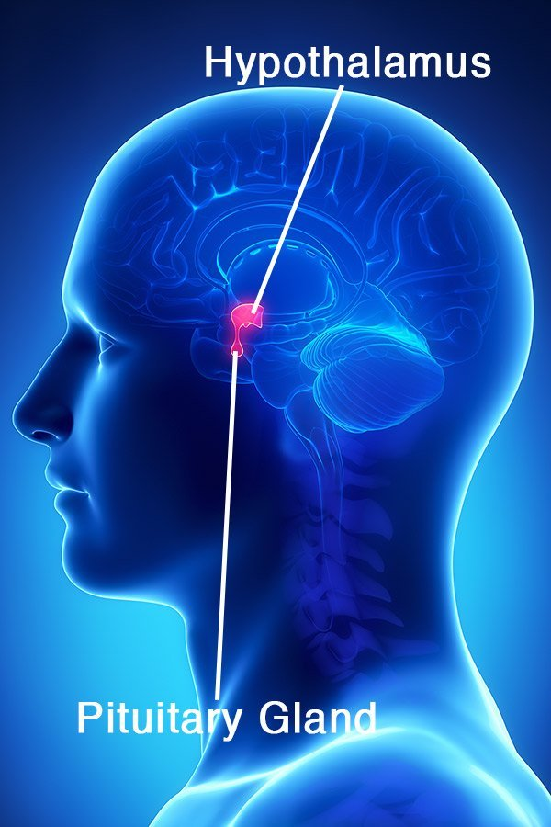
Hypothalamus
In the brain
Monitors and regulates body temperature
Receives information about temperature from 2 sources:
1-thermoreceptors in the skin that detect environmental temperature
2-thermoreceptors in the hypothalamus that detect blood temperature

Slide 25
Over heating
Body temperature rises above normal
Thermoreceptors of the skin and hypothalamus are stimulated. As a result:
- Arterioles of the skin dilate( vasodilation), shunt vessels constrict--→more blood flow to the skin, heat lost by radiation and convection
- Sweat glands become more active--→ more sweat is produced
-Evaporation of water from the sweat on skin, more latent heat is lost.
-Metabolic rate is decreased to reduce the amount of heat produced by the body
Hair lies flat: The erector muscles in the skin relax, so that the hairs lie flat on the surface

Slide 26
Overcooling
Body temperature falls below normal
Thermoreceptors in the skin and hypothalamus are stimulated
- Arterioles of the skin constrict( vasoconstriction), shunt vessels dilate→ less blood flow to the skin, less heat is lost by radiation and convection
Sweat glands become less active--→ less sweat is produced
Metabolic rate is increased to increase the amount of heat produced by the body
When the above response are insufficient, shivering occurs
(spasmodic contraction of the skeletal muscles)
Hair stands up When the hair erector muscle contracts, it pulls the hair more upright. In mammals, this makes the fur or hair stand up more and so provides a thicker layer of insulating air in cold weather. Air is a bad conductor of heat and so this layer of air insulates the body against heat loss.

